Slide 1
RETAIL SALES PREDICTION
BY
P. SUSANNAH JOY
221FA14025
III BI-A

Slide 2
INTRODUCTION
Retail sales prediction refers to the process of forecasting future sales for a retail business based on historical sales data and other influencing factors. The goal is to estimate future sales, helping retailers make informed decisions on inventory management, staffing, marketing, and overall business strategy.
Regression is a statistical method used to determine the relationship between a dependent variable (the target) and one or more independent variables (the predictors). It helps in predicting the future values of the dependent variable based on the values of the independent variables.
Linear regression is a statistical method used to model the relationship between a dependent variable (also called the response variable) and one or more independent variables (predictors or explanatory variables).

Slide 3
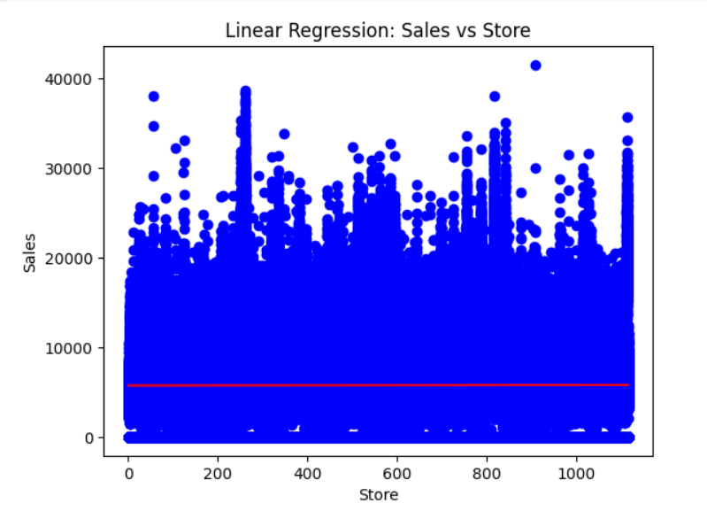
PYTHON OUTPUT OF ROSSMANN STORES DATA USING GOOGLE COLAB
This graph belongs to Rossmann Stores Data
Store vs Sales
X= Store
Y= Sales
Data points: The distribution of blue dots indicates that sales are scattered across stores, with no clear linear pattern.
Regression Line: The red line represents the predicted sales based on the linear regression model, which appears almost flat, suggesting that the regression model has a very weak or no significant relationship between sales and store ID.
The data points we have in this linear regression graph are:
Root Mean Squared Error: 6185.848323962925
R-squared: 0.8531726914945948
Mean Squared Error:38264719.48707493
MSA: 5773.818972305593

Slide 4
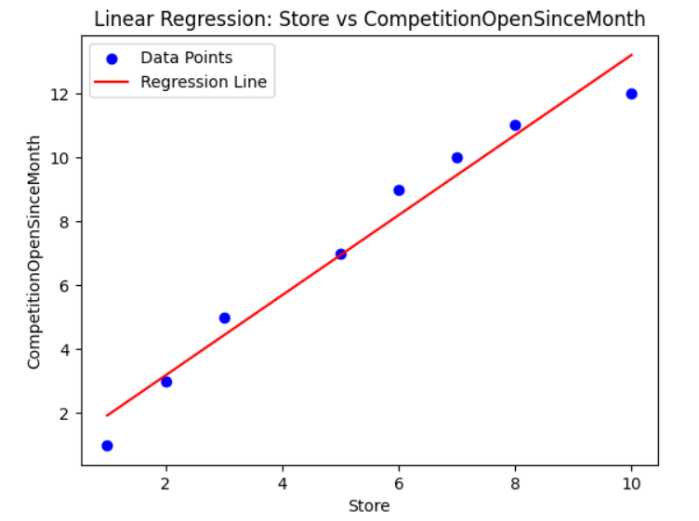
PYTHON OUTPUT OF STORES DATA USING GOOGLE COLAB
This graph belongs to Stores Data
Store vs CompetitionOpenSinceMonth
X= Store
Y= CompetitionOpenSinceMonth
Data points: The distribution of blue dots indicates that sales are scattered across stores, with no clear linear pattern.
Regression Line: The red line represents the predicted sales based on the linear regression model, which appears almost flat, suggesting that the regression model has a very weak.
The data points we have in this linear regression graph are:
Root Mean Squared Error: 6185.848323962925
R-squared: 0.8531726914945948
Mean Squared Error:38264719.48707493
MSA: 5773.818972305593

Slide 5
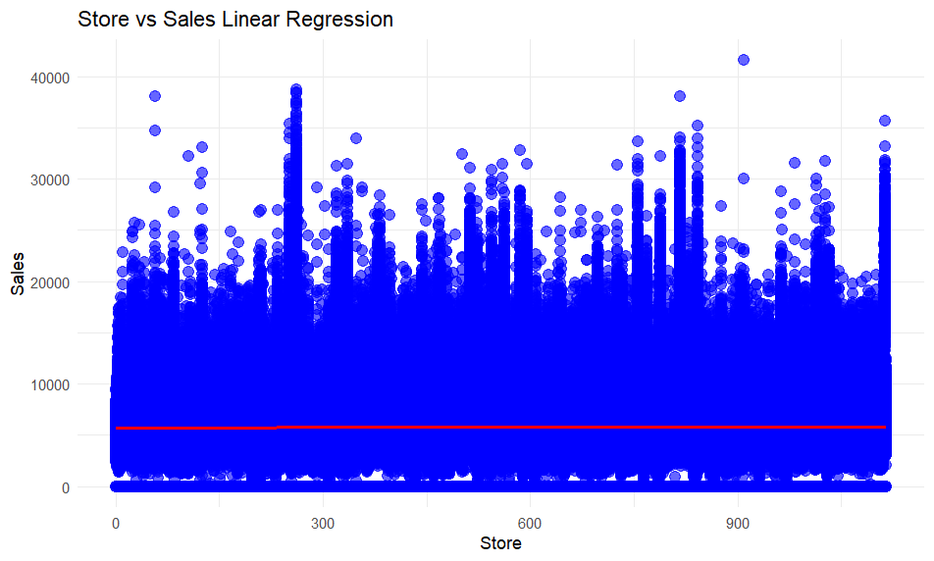
R OUTPUT OF ROSSMANN STORES DATA USING R STUDIO
This graph belongs to Rossmann Stores Data
Store vs Sales
X= Store
Y= Sales
Data points: The distribution of blue dots indicates that sales are scattered across stores, with no clear linear pattern.
Regression Line: The red line represents the predicted sales based on the linear regression model, which appears almost flat, suggesting that the regression model has a very weak or no significant relationship between sales and store ID.
The data points we have in this linear regression graph are:
Root Mean Squared Error: 6185.848323962925
R-squared: 0.8531726914945948
Mean Squared Error:38264719.48707493
MSA: 5773.818972305593

Slide 6
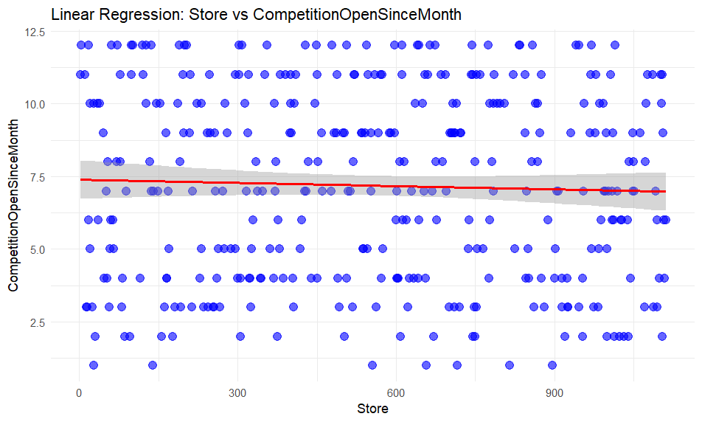
R OUTPUT OF STORES DATA USING R STUDIO
This graph belongs to Stores Data
Store vs CompetitionOpenSinceMonth
X= Store
Y= CompetitionOpenSinceMonth
Data points: The distribution of blue dots indicates that sales are scattered across stores, with no clear linear pattern.
Regression Line: The red line represents the predicted sales based on the linear regression model, which appears almost flat, suggesting that the regression model has a very weak.
The data points we have in this linear regression graph are:
Root Mean Squared Error: 6185.848323962925
R-squared: 0.8531726914945948
Mean Squared Error:38264719.48707493
MSA: 5773.818972305593

Slide 7
THANK YOU

